Slide 1
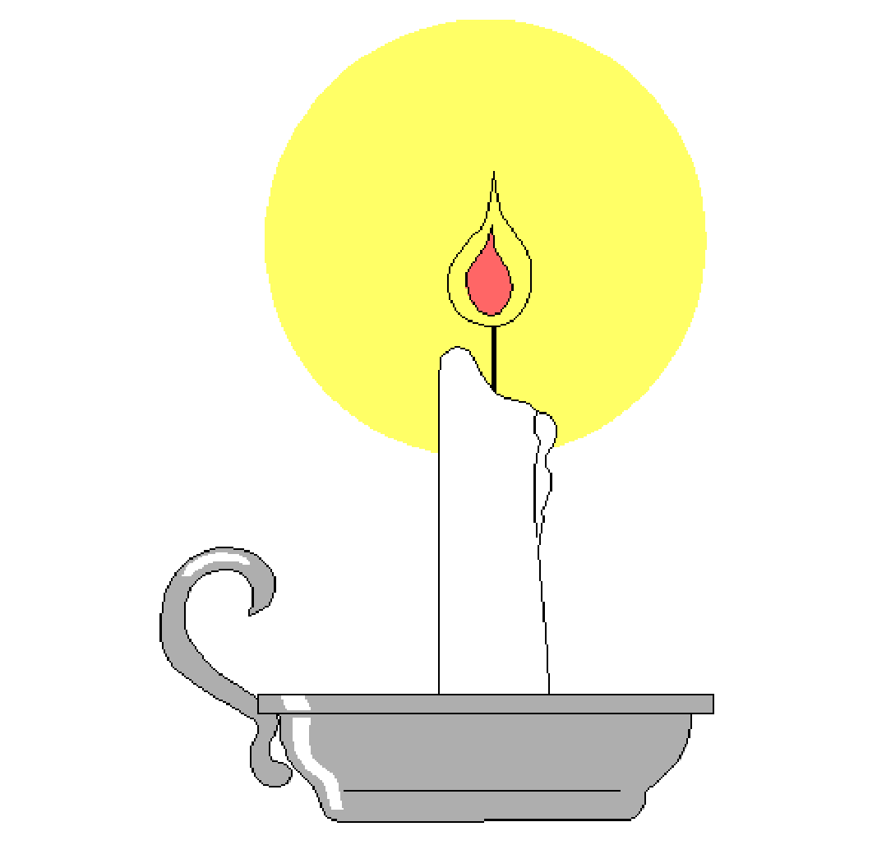
Let the Light Shine
Light a candle for the winter holidays of different religions and cultures,
Let the light shine to remind us of peace and love on Earth.
Sing a joyous song and celebrate family, tradition and spirit
Let the music be a reminder of peace and love on Earth.

Slide 2
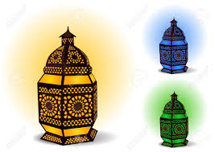
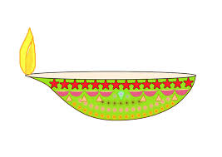
Let the Light Shine
The lights of Ramadan sparkle on this Muslim holiday
People look inside themselves, to reflect, fast and pray.
The lights of Diwali glisten on truth and humanity
Hindu people turn away from the dark and let the light set them free.

Slide 3
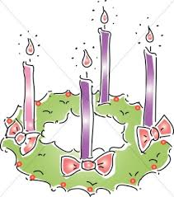
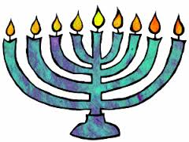
Let the Light Shine
The lights of Chanukah glow in the menorah for eight days and nights
Jewish families celebrate the Festival of Lights.
The lights of Christmas twinkle like the stars in the midnight sky
Christian children patiently wait for Santa’s sleigh to stop by.

Slide 4
Let the Light Shine
Light a candle for the winter holidays of different religions and cultures,
Let the light shine to remind us of peace and love on Earth.
Sing a joyous song and celebrate family, tradition and spirit
Let the music be a reminder of peace and love on Earth.

Slide 5
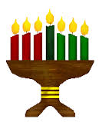
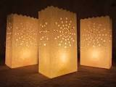
Let the Light Shine
The luminarias of Las Posadas shimmer a warm, soft, glow
Friends and family give comfort and love in the homes of Mexico.
The Kwanzaa lights burn in a kinara with candles of red, black and green
African people celebrate strength, faith and unity.

Slide 6
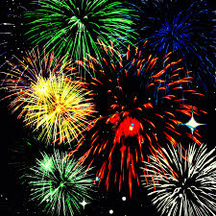
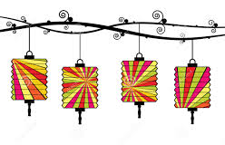
Let the Light Shine
The fireworks of New Year’s Eve burst brightly in the sky
World cultures say farewell to another year passed by.
The lanterns of Chinese New Year flicker big and bright
At the closing of this holiday on the fifteenth day and night.

Slide 7
Let the Light Shine
Light a candle for the winter holidays of different religions and cultures,
Let the light shine to remind us of peace and love on Earth.
Sing a joyous song and celebrate family, tradition and spirit
Let the music be a reminder of peace and love on Earth.

